Slide 1
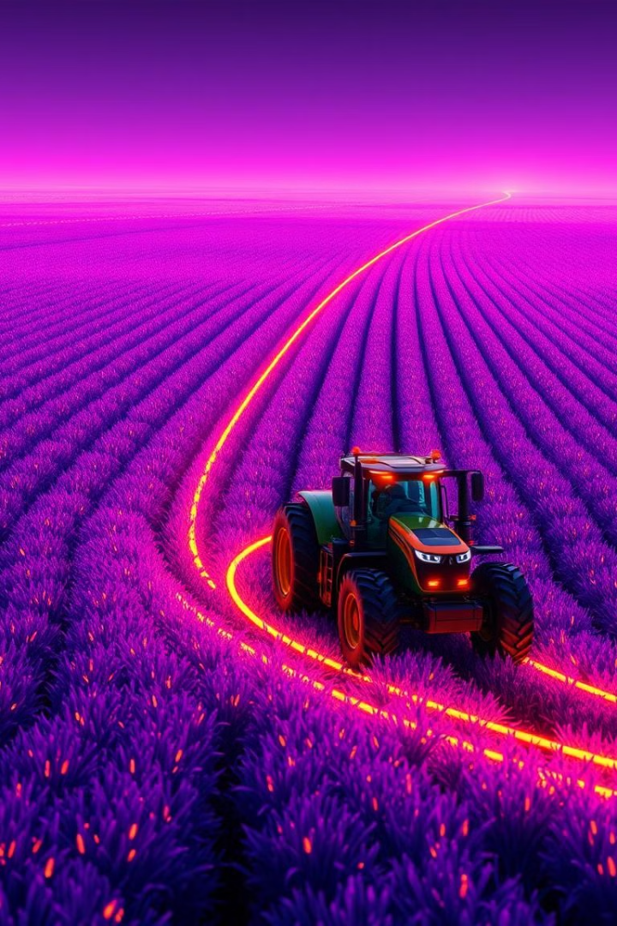
Welcome to Smart Agriculture Farming
Notes:
1

Slide 2
Presented By:
Nahid Hasan
ID: 18CSE248
Session: 2018-19
Dept. of CSE, BSMRSTU
Project Supervisor:
Dr. Saleh Ahmed
Associate Professor
Dept. of CSE, BSMRSTU
Notes:
2

Slide 3
Contents
Introduction
Challenges in Traditional Farming
Objectives
System Architecture
Data Collection
Machine Learning Models
Implementation
Results
Challenges
Conclusion
Notes:
3

Slide 4
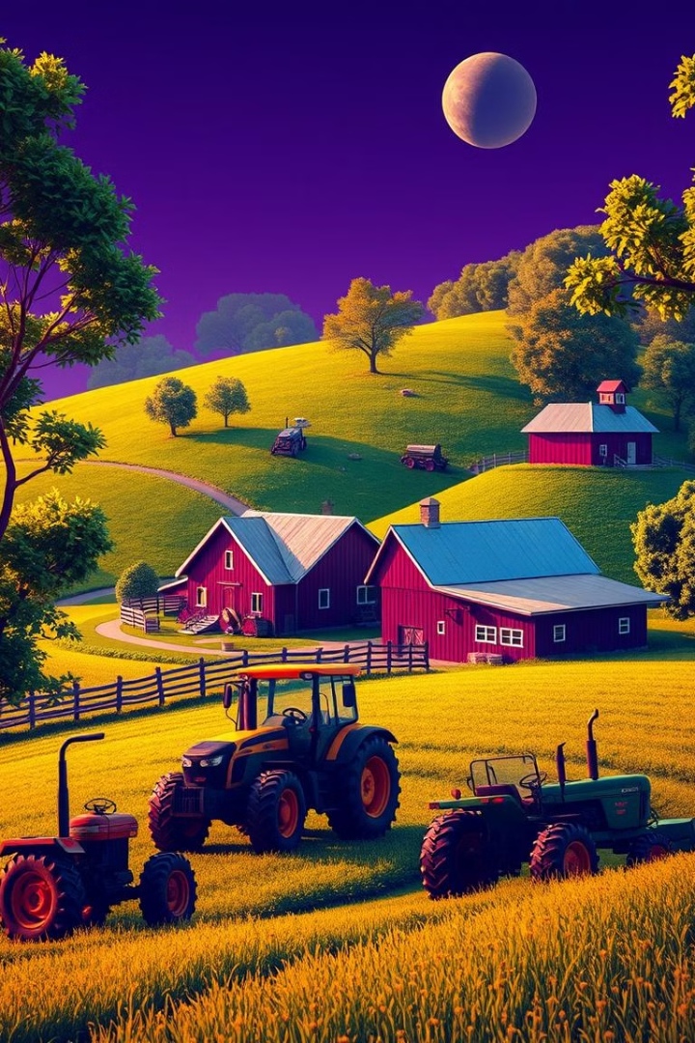
Introduction
Smart Agriculture Farming is an innovative project that leverages modern technologies to transform traditional farming practices. By integrating data-driven decision-making, this project aims to improve crop yields, optimize resource utilization, and enhance overall agricultural productivity.
The importance of this project lies in its potential to address the growing global demand for food while adapting to the challenges posed by climate change and resource scarcity.
Notes:
4

Slide 5

Cont.
1
Crop Recommendation
2
Fertilizer Recommendation
User can provide the soil data from their side and the application will predict which crop should the user grow.
The application will predict what the soil lacks or has excess of and will recommend improvements.
3
Disease Prediction
The application will predict what disease it is and will also give a little background about the disease and suggestions to cure it.
Notes:
5

Slide 6
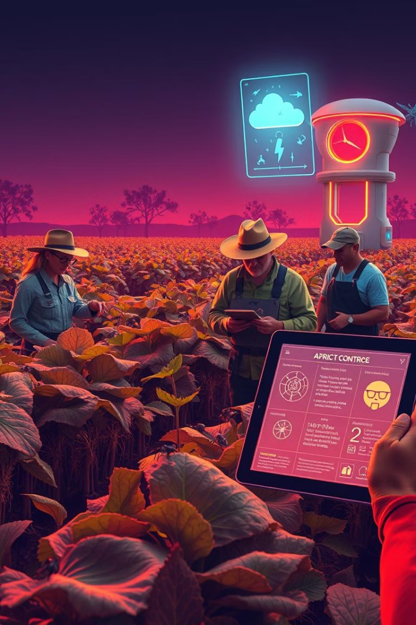
Challenges in Traditional Farming
Inefficient Crop Selection
Overuse of Fertilizers
Indiscriminate use of fertilizers can harm the environment and lead to soil degradation.
Farmers often struggle to choose the right crops for their local conditions, leading to suboptimal yields.
Disease Outbreaks
Unpredictable Weather
Crop diseases can devastate yields, and traditional methods often fail to detect and prevent them in time.
Changing climate patterns make it increasingly challenging for farmers to plan and adapt their practices.
Notes:
6

Slide 7
Objectives
Productivity Enhancement
Resource Waste Reduction
Disease Detection and Recommendations
Maximize crop yields through optimized resource allocation and cultivation practices.
Minimize the use of water, fertilizers, and pesticides, promoting sustainable farming.
Provide farmers with timely and accurate insights for disease prevention and management.
Notes:
7

Slide 8
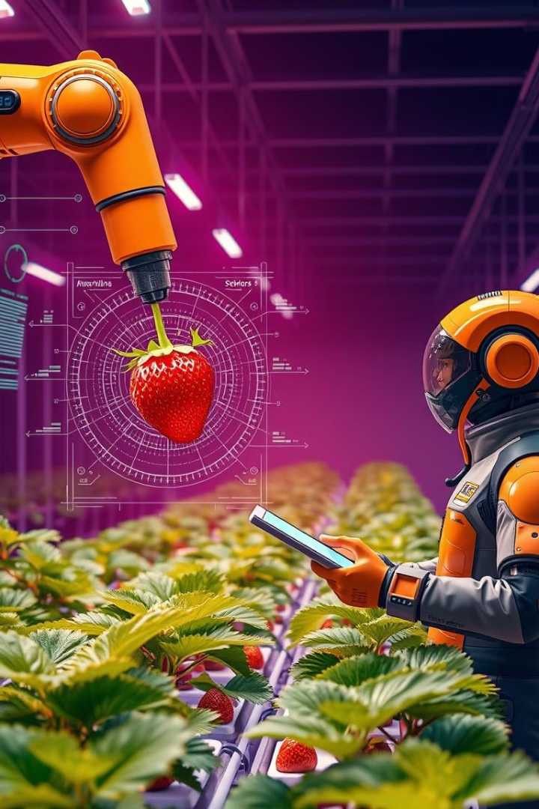
System Architecture
Data Collection
1
Gather soil, climate, crop and disease image data from agricultural databases and Agriculture Training Institute (A.T.I).
Machine Learning Models
2
We employ advanced algorithms to analyze the collected data and provide insights for crop, fertilizer, and disease management.
Farmer Interface
3
Farmers can access our user-friendly platform to receive personalized recommendations and make informed decisions.
Notes:
8

Slide 9
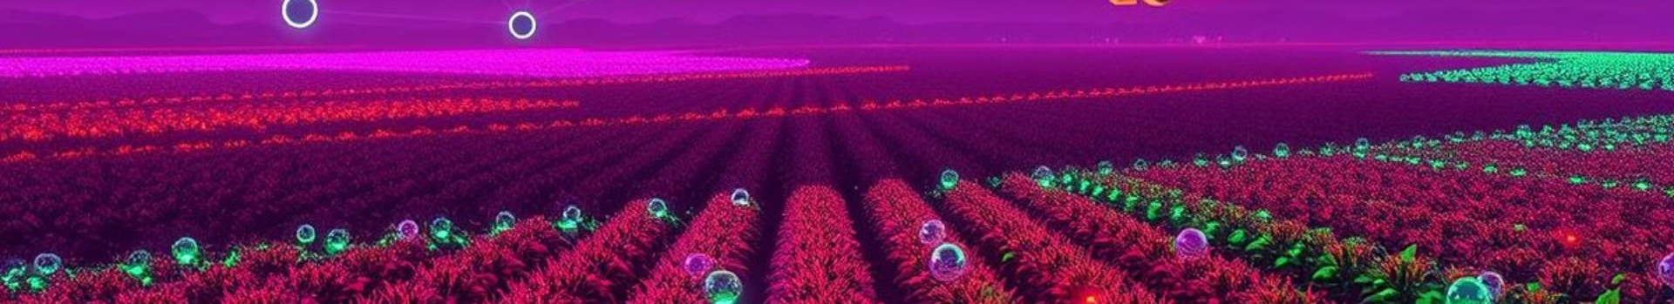
Data Collection
Crop Data
Soil Quality
Weather Data
Historical crop yields
Nutrient levels
Temperature
Disease incidence
Texture and composition
Precipitation
Planting schedules
Moisture content
Wind speed
We preprocess the collected data, addressing any missing values and normalizing the features to ensure reliable model training.
Notes:
9

Slide 10
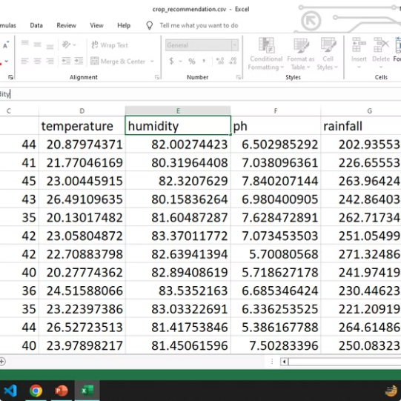
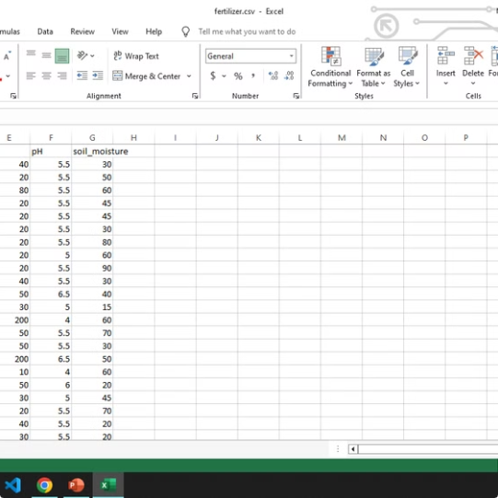
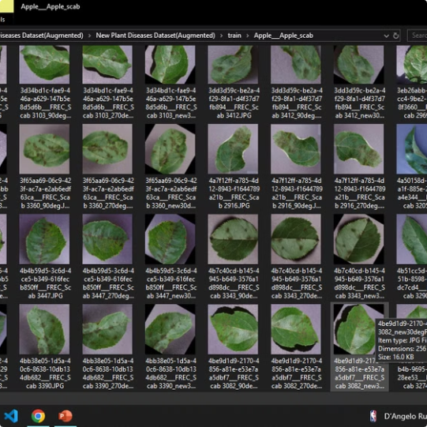
Cont.
Crop Data
Fertilizer Data
Disease Data
Notes:
10

Slide 11
Machine Learning Models
Crop Recommendation
Fertilizer Recommendation
Disease Prediction
We employ a Random Forest classifier to predict the most suitable crops based on environmental factors and historical data.
Our system is purely python logic based. In this we compare the data with the user's entered data.
A Convolutional Neural Network (CNN) model analyzes plant images to detect and predict the onset of various diseases.
Notes:
11

Slide 12
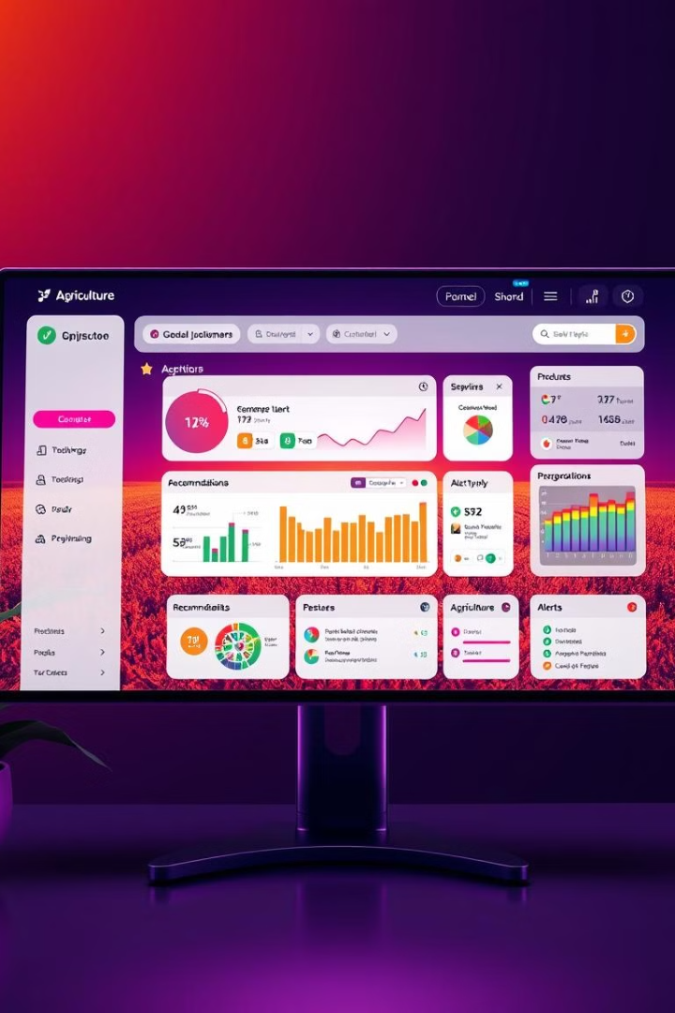
Implementation
1
Web Application
2
Computer Vision
We developed a Flask-based web application to provide a user-friendly interface for farmers to access our recommendations.
We leveraged OpenCV, a powerful computer vision library, to process and analyze plant images for disease detection.
3
Deployment
Our system is deployed on a scalable cloud platform like render, ensuring seamless access and real-time updates for our users.
Notes:
12

Slide 13


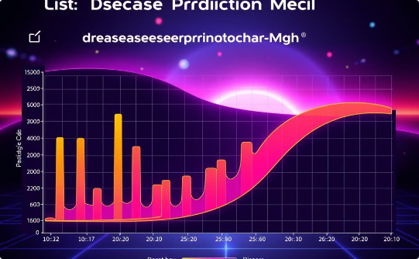
Results
Crop Recommendation Accuracy
Fertilizer Recommendation Effectiveness
Disease Prediction Accuracy
Our CNN-based disease detection model achieved an accuracy of 99.2% in identifying and predicting crop diseases.
Our Random Forest model achieved an accuracy of 99% in recommending the most suitable crops for specific farming conditions.
The nutrient having maximum difference is made as HIGH or LOW and according to that suggestions will be fetched.
Notes:
13

Slide 14
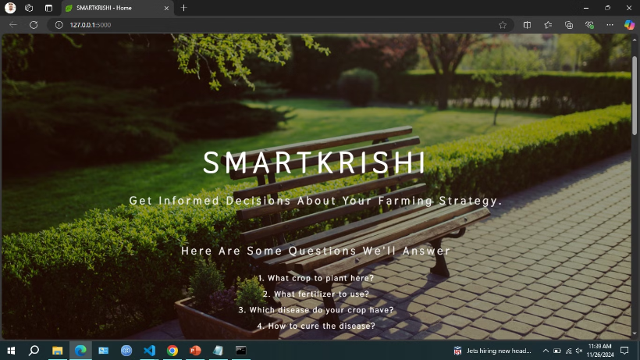
Home Page
This is the home page of smart agriculture website.
Notes:
14

Slide 15
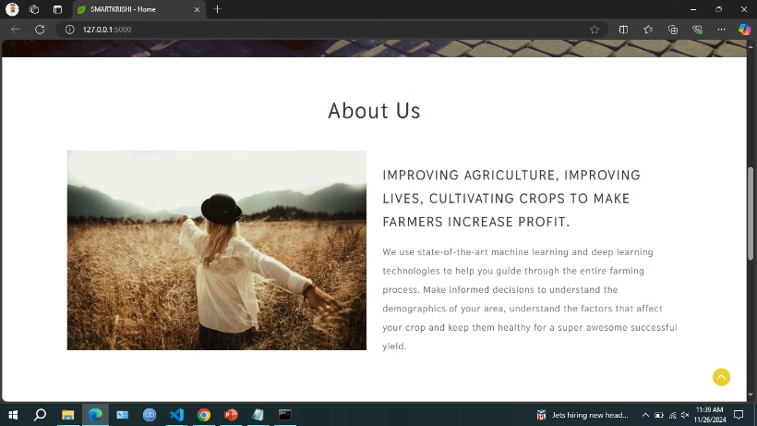
About Page
This is the about page of smart agriculture website.
Notes:
15

Slide 16
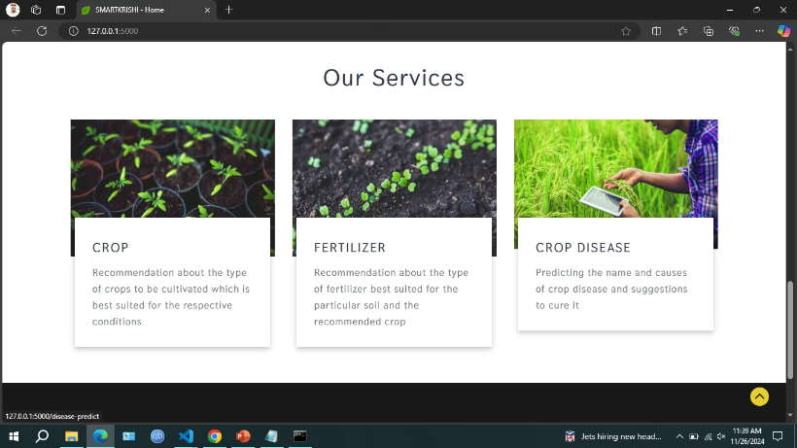
Our Services
This is the our services page of smart agriculture website.
Notes:
16

Slide 17
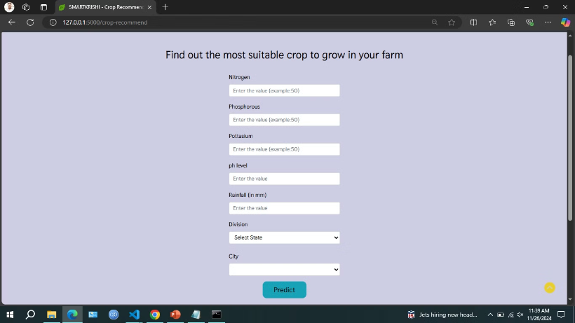
Crop Recommendation (Input)
This is the crop recommendation input page of smart agriculture website.
Notes:
17

Slide 18
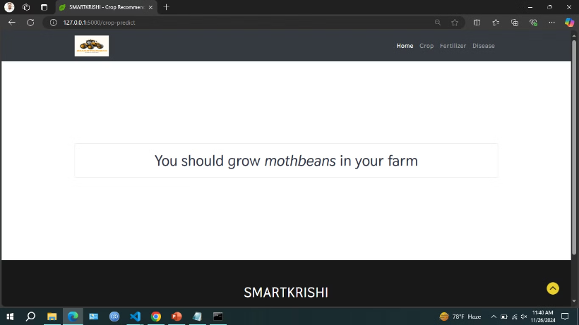
Crop Recommendation (Output)
This is the crop recommendation result page of smart agriculture website.
Notes:
18

Slide 19
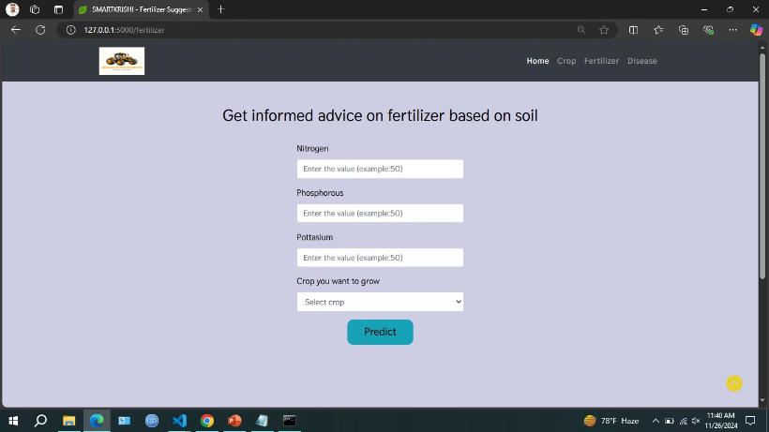
Fertilizer Suggestion (Input)
This is the fertilizer suggestion input page of smart agriculture website.
Notes:
19

Slide 20
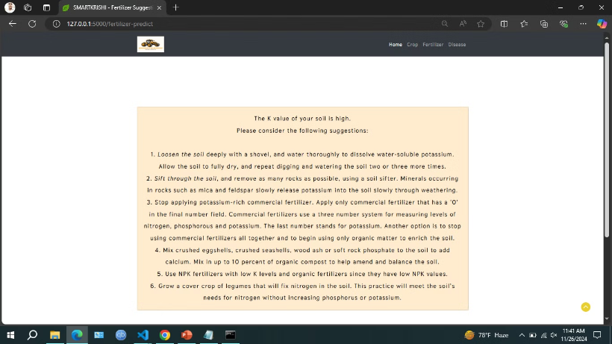
Fertilizer Suggestion (Output)
This is the fertilizer suggestion output page of smart agriculture website.
Notes:
20

Slide 21
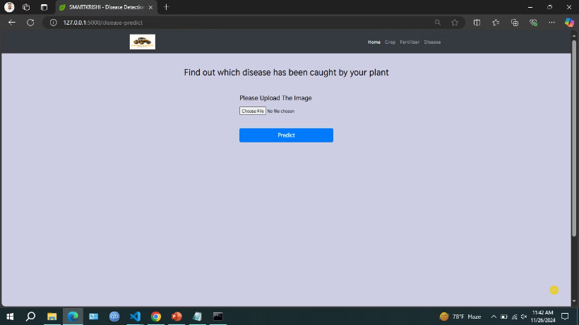
Crop Disease Prediction (Input)
This is the crop disease prediction page of smart agriculture website.
Notes:
21

Slide 22
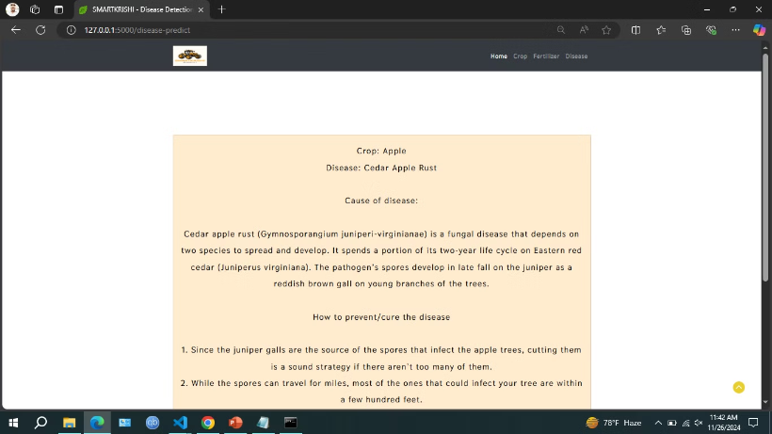
Crop Disease Prediction (Output)
This is the crop disease prediction output page of smart agriculture website.
Notes:
22

Slide 23
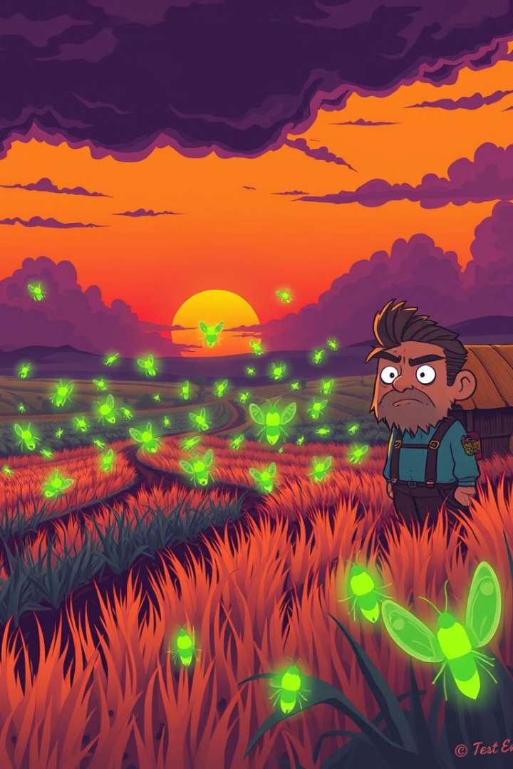



Challenges
Dataset Limitations
Obtaining comprehensive and reliable agricultural data can be a significant challenge, which can impact the accuracy of our models.
Model Tuning
Optimizing the performance of our machine learning models required extensive experimentation and hyperparameter adjustments.
Real-Time Integration
Integrating our system with real-time data sources, such as weather sensors and satellite imagery, remains an ongoing challenge.
Notes:
23

Slide 24

Conclusion
This project ensures a smarter and more efficient farming experience by providing accurate recommendations and disease predictions, helping farmers make data-driven decisions for improved productivity and sustainability.
Notes:
24

Slide 25
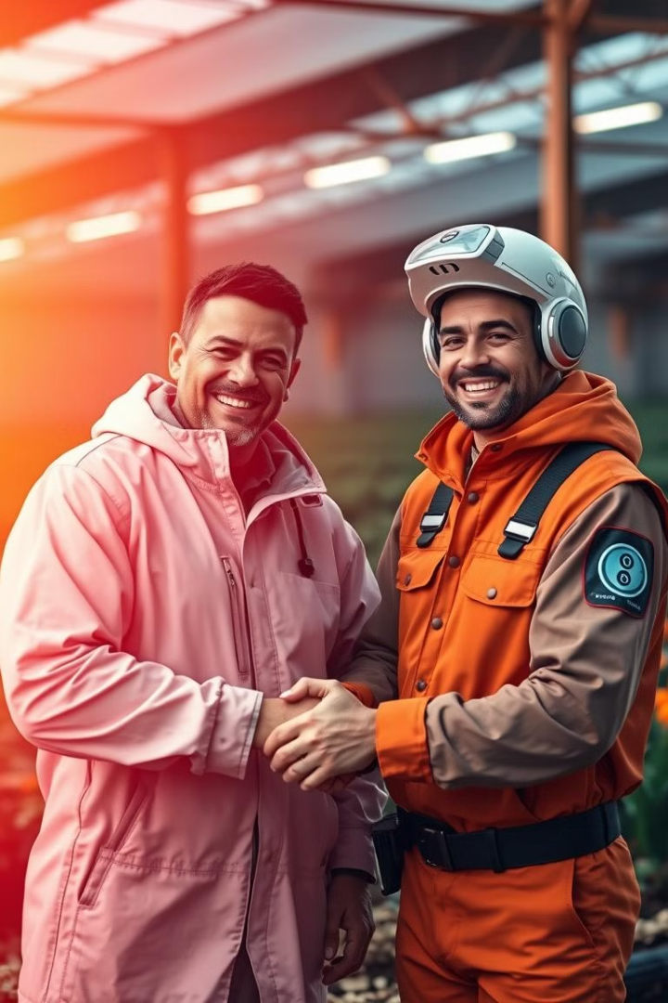
Thank You
"If the Farmer is Rich, then so is the Nation"
Notes:
25

